Slide 1
Study Note - 2
FORMS OF MARKET

Slide 2
Market
In economics, market means a social system through which the sellers and purchasers of a commodity or a service (or a group of commodities and services) can interact with each other.
• They can participate in sale and purchase. • Market does not refer to a particular place or location.
• It refers to an institutional relationship between purchasers and sellers.
• Market is an arrangement which links buyers and sellers. • A market can be of different types.
• The market differ from one another due to differences in the number of buyers, number of sellers, nature of the product, influence over price, availability of information, conditions of supply etc.

Slide 3
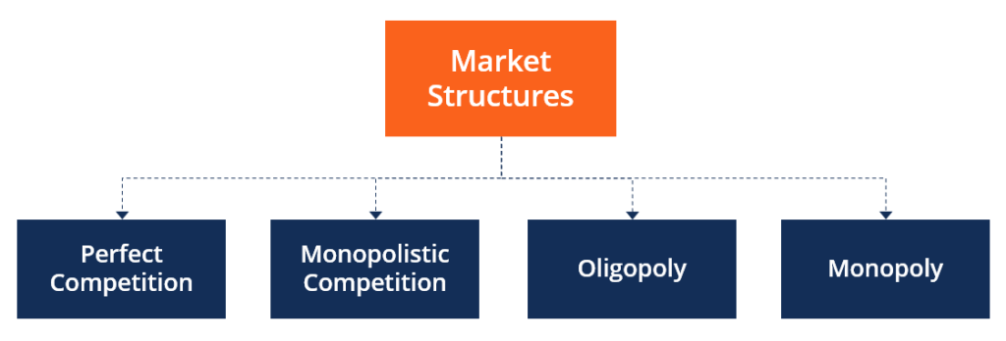
Economists discuss four broad categories of market structures:

Slide 4
1. Perfect Competition
Pure or perfect competition is a theoretical market structure in which the following criteria are met: All firms sell an identical product (the product is a "commodity" or "homogeneous").
All firms are price takers (they cannot influence the market price of their product).

Slide 5
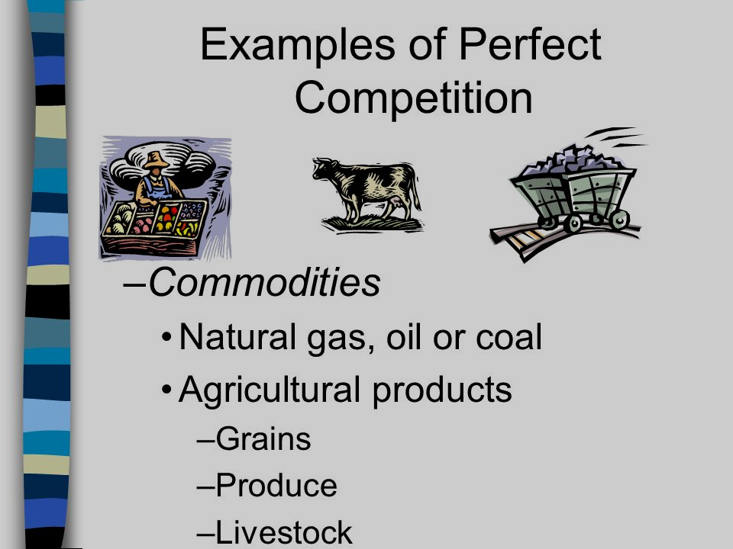

Slide 6
Market is said to be Perfectly Competitive if it satisfies the following features:-
Large number of buyers and sellers : Under perfect competition, there exists a large number of sellers and the share of an individual seller is too small in the total market output. As a result a single firm cannot influence the market price so that a firm under perfect competition is a price taker and not a price maker. Similarly, there are a large number of buyers and an individual buyer buys only a small portion of the total output available.
Homogenous goods : Under perfect competition all firms sell homogenous goods which are identical in quantity, shape, size, colour, packaging etc. So the products are perfect substitutes of each other.

Slide 7
Free entry and free exit : Any firm can enter or leave the industry whenever it wishes. The condition of free entry and free exit ensures that all the firms under perfect competition will earn normal profits in the long run.
(iv) Profit maximization :- The goal of all firms is maximization of profit.
(v) No Government regulation :- There is no Government intervention in the market.

Slide 8
2 Imperfect Competition
Imperfectly competitive markets may be classified as :
(i) Monopoly,
(ii) Monopolistic Competition,
(iii) Oligopoly and
(iv) Duopoly

Slide 9
(vi) Perfect mobility of factors :- Resources can move freely from one firm to another without any restriction. The labours are not unionized and they can move between jobs and skills.
(vii) Perfect knowledge :- Individual buyer and seller have perfect knowledge about market and information is given free of cost. Each firm knows the price prevailing in the market and would not sell the commodity which is higher or lower than the market price.

Slide 10
(1) Monopoly
Monopoly refers to the market situation where there is one seller and there is no close substitute to the commodities sold by the seller.
The seller has full control over the supply of that commodity. Since there is only one seller,
so a monopoly firm and an industry are the same.

Slide 11
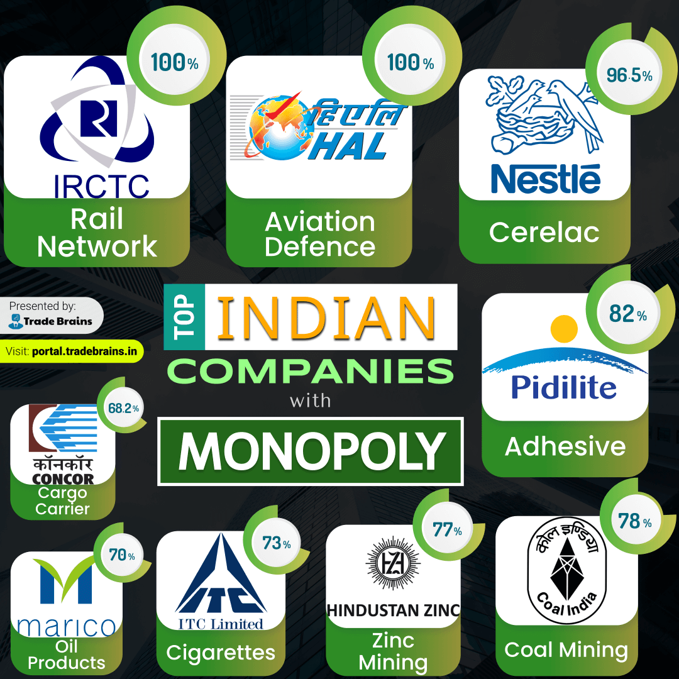

Slide 12
Features :
Single seller and large number of buyers : Under monopoly there is one seller and therefore a firm faces no competition from other firms. Though there are large numbers of buyers, no single buyer can influence the monopoly price by his action.
(ii) No close substitute : Under monopoly there is no close substitute for the product sold by the monopolist. According to Prof. Boulding, a pure monopolist is therefore a firm producing a product which has no substitute among the products of any other firms.

Slide 13
(iii) Restriction on the entry of new firms : Under monopoly new firms cannot enter the industry.
(iv) Price maker :- A monopoly firm has full control over the supply of its products and hence it has full control over its price also. A monopoly firm can influence the market price by varying it supply, for eg., It can make the price of its product by supplying less of it.
(v) Possibility of Price Discrimination : Price discrimination is defined as that market situation where a single seller sell the same commodity at two different prices in two different markets at the same time, depending upon the elasticity of demand on the two goods in their respective market. Under such circumstances a monopolist can incur supernormal loss then firms would leave the industry, thus reducing the supply. As a result, price will again rise and the loss will wiped out.

Slide 14
(2) Monopolistic Competition
It is that form of market in which there are large numbers of sellers selling differentiated products which are similar in nature but not homogenous,
for eg., the different brands of soap. This are closely related goods with a little difference in odour, size and shape.
We separate them from each other. The concept of monopolistic competition was developed by an American economist “Chamberline”. It is a combination of perfect competition and monopoly.

Slide 15
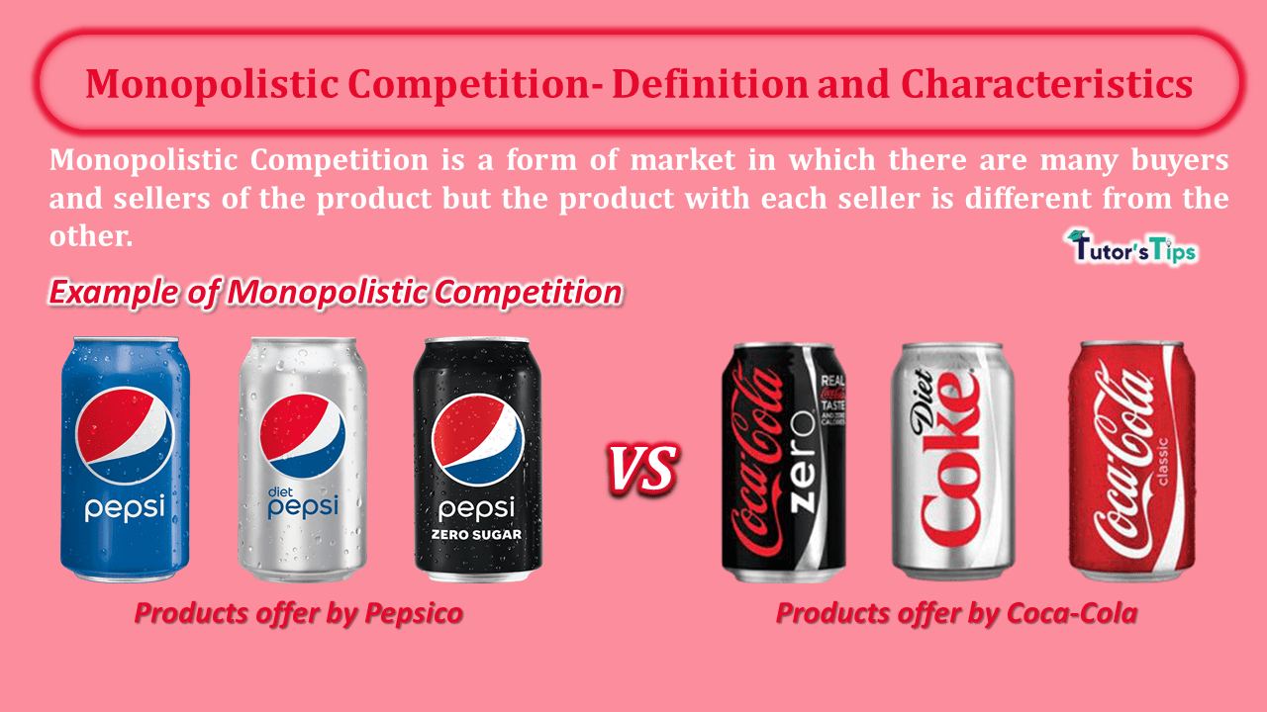

Slide 16
Features :
(i) Large number of sellers and buyers : In monopolistic competition the number of sellers is large and each other act independently without any mutual dependence. Here the action of an individual firm regarding change in price has no effect on the market price. The firms under monopolistic competition are not price takers.

Slide 17
(ii) Product Differentiation :
Most of the firms under monopolistic sale products which are not homogenous in nature but are close substitutes. Products are differentiated from each other in the following ways:
(a) Real Differentiation : These types of product differentiation arises due to differences in the quality of inputs used in making these products, differences in location of firms and their sales service.
(b) Artificial Differentiation : It is made by the sellers in the minds of the buyers of those products through advertisements, attractive packing, etc

Slide 18
(iii) Non-price competition :
In this case, different firms may compete with each other by spending a huge sum of money on advertisements keeping the product prices unchanged.
(iv) Selling Cost :
Expenditure incurred on advertisements and sales promotion by a firm to promote the sale of its product is called selling cost. They are made to persuade a particular product in preference to other products. Some advertisements have become so popular that people use a brand name to describe the product, for eg., brand name is used to describe all types of washing powder.

Slide 19
(v) Free entry and free exit :
There are no restrictions on the entry of new firms and the firms decide to leave the industry. Every firm under monopolistic competition earns only normal profits in the long run and there arises no supernormal profit nor loss.
(vi) Independent price policy :
A firm under monopolistic competition can influence the price of the commodity to some extent and hence they face an inverse relationship between price and quantity. In this case the price elasticity of demand would be relatively elastic because of the existence of many substitutes.

Slide 20
(3) Oligopoly
Oligopoly is a market situation in which there are few firms producing either differential goods or closely differential goods. The number of firms is so small that every seller is affected by the activities of the others.

Slide 21
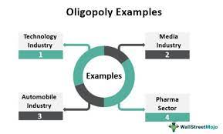

Slide 22
Features :
(i) Few Sellers :
There are few sellers in oligopoly market, such that number of sellers is small that each and every seller is affected by the activities of the others.
(ii) Interdependence :
Interdependence among firms is the most important characteristic under Oligopoly. The number of sellers is so less in the market that each of these firms contribute a significant portion of the total output. As a result, when any one of them undertakes any measure to promote sales, it directly affect other firms and they also immediately react. Hence every firm decides its policy after taking into consideration the possible reaction of the rival firm. Thus every firm is affected by the activities of the other firms and this is called interdependence of firm.

Slide 23
(iii) Nature of Product :
A firm under oligopoly may produce homogenous goods which is called oligopoly without product differentiation for eg. Cooking gas supplied by Indian Oil & HP.
Oligopoly may also produce differential products which is called oligopoly with product differentiation for eg. Automobile Industry.
Barrier to Entry :
The existence of oligopoly in the long run requires the existence of barrier to the entry of the new firms. Several factors such as unlimited size of the market, requirement of huge initial investment etc. creates such barrier upon the entry of new firms.

Slide 24
CONCEPTS OF TOTAL REVENUE, AVERAGE REVENUE AND MARGINAL REVENUE
Total Revenue (TR)-
Total revenue is the total sale proceeds of a firm by selling certain units of a commodity at a given price.
For eg : If a firm sell 10 units of a commodity at ` 20 each,
Them TR = 20 x 10 = ` 200.00
Thus total revenue its price per unit multiplied by the number of units sold.

Slide 25
Average Revenue (AR) -
Average Revenue is the revenue earned per unit of output. Average Revenue is found out by dividing the total revenue by the number of units sold.
AR = TR/Q TR = P.Q Thus AR = P.Q/Q = P

Slide 26
Marginal Revenue –
Marginal Revenue is the change in total revenue resulting from sale of an additional unit of the commodity.
e.g If a seller realises ` 200.00 after selling 10 units and `225 by selling 11 units,
we say MR = (225.00 - 200.00) = ` 25.00
Mathematically it can be expressed as MR = dTR/ dQ Where d is the rate of change

Slide 27
Price Discrimination under Monopoly
Sometimes the monopolist charges different prices to different consumers for the same commodity. • A company producing electricity may charge one price for domestic consumers and another for industrial consumers. • Sometimes, in order to capture a foreign market, a monopolist keeps the export price lower than the price in the domestic market. (This is called ‘dumping’). • Sometimes exactly the opposite is done. A low price is charged for domestic consumers but the price is raised when the good is sold to a rich foreign nation. • All these are cases of price discrimination. • When a monopolist discriminated the price between consumers, the practice is called ‘price discrimination’

Slide 28
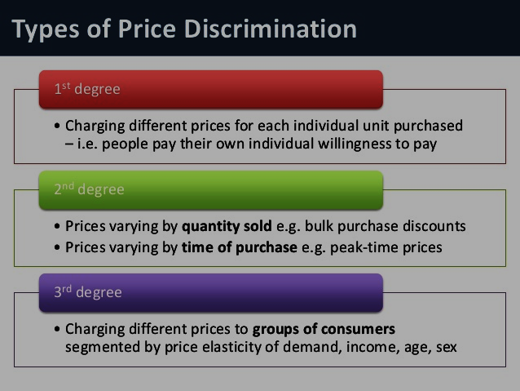
Degrees of price discrimination

Slide 29
Pricing Strategies
Cost-plus pricing Cost-plus pricing isthe simplest pricing method. The firm calculates the cost of producing the product and adds on a percentage (profit) to that price to give the selling price.
• Limit pricing A limit price is the price set by a monopolist to discourage economic entry into a market, and is illegal in many countries.
• Penetration pricing Setting the price low in order to attract customers and gain market share. The price will be raised later once this market share is gained. • Price discrimination Setting a different price for the same product in different segments to the market. For example, this can be for different classes, such as ages, or for different opening times.
• Psychological pricing Pricing designed to have a positive psychological impact. For example, selling a product at ` 3.95 or ` 3.99, rather than ` 4.00.
• Dynamic pricing A flexible pricing mechanism made possible by advancesin information technology, and employed mostly by Internet based companies.

